Slide 1

L5 Forensic Anthropology and Taphonomy
Basic Surveying and Planning
(Baseline and Offset Measurements)

Slide 2
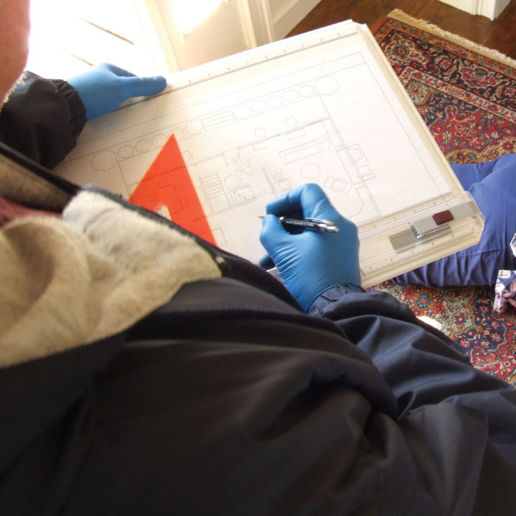
Importance of Plans
Crime scene sketches and plans allow the viewer to quickly and easily understand the inter-relationship of the scene and the evidence
  Relationship of different parts of an area to one another
  Spatial relationships of different evidence artefacts to one another
  An aid to understanding sequence
  Allows you to recreate the scene
The act of sketching makes the examiner or forensic anthropologist focus their observations and think about how to approach and evaluate the terrain.

Slide 3
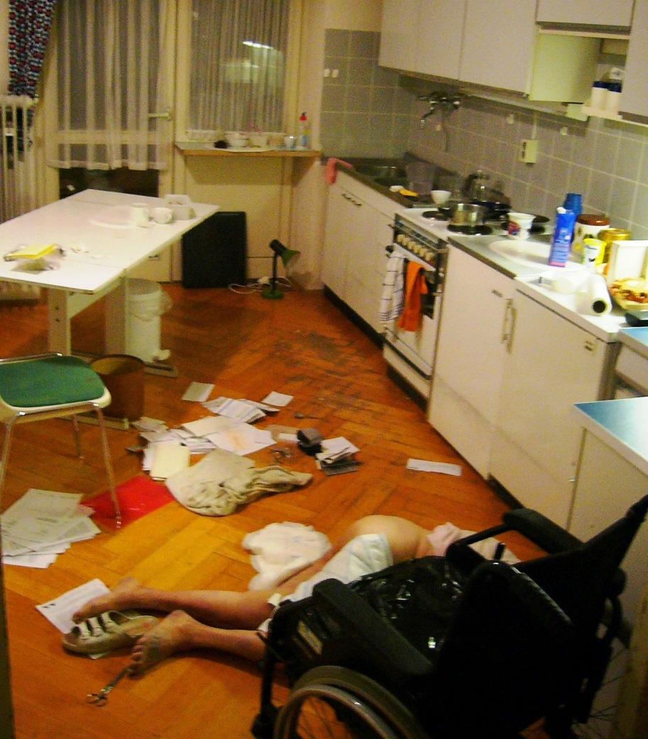
Importance of Plans
How much detail ?
An indoor scene is usually well defined
  Walls, doors, furniture and fittings
Evidence is concentrated within a small area
Misplaced, disturbed or out of place artefacts

Slide 4
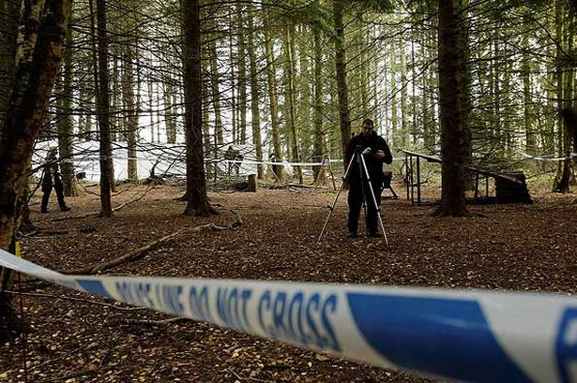
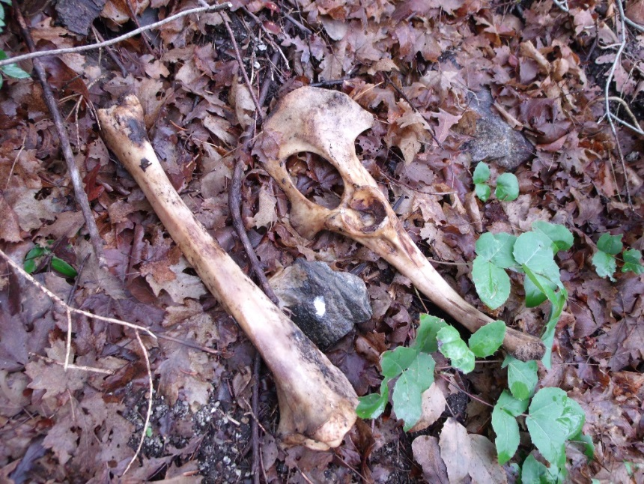
What about outdoor scenes?
Outdoor scenes are trickier
Can be larger, multiple access points, no set borders or confines
Can have more ‘background’ information
How can we be sure to recreate the scene?

Slide 5
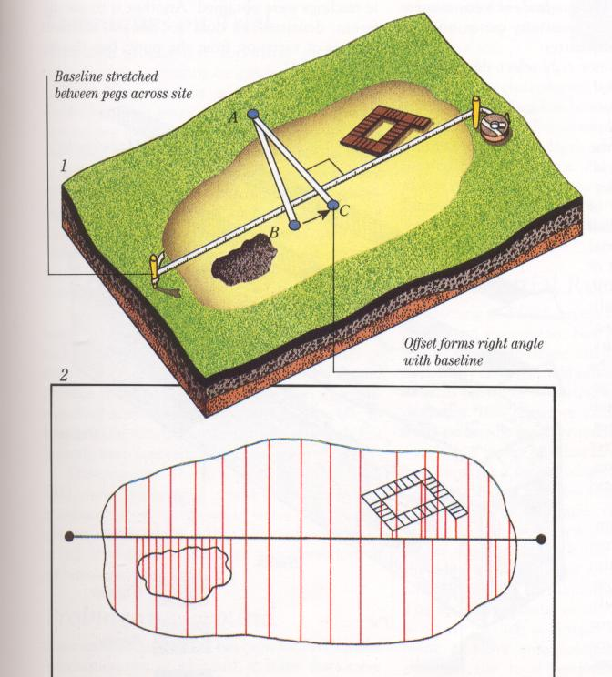
Planning a Scene
Using offset measurements to record the location of objects

Slide 6
Offset Measurements
Quick and easy technique
Requires 30 m tape and 3m hand tape, notebook and pencil and two to four people
Lay base line through your scene (or alongside it)
Take measurements of offsets at right angle to edge of features or objects

Slide 7
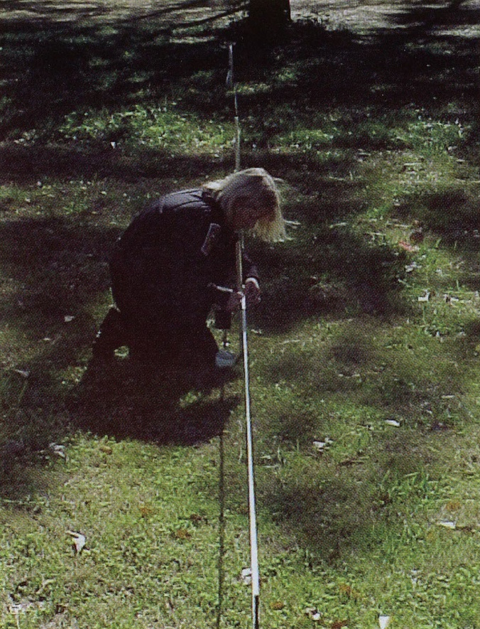

Laying a Baseline
Adjacent to, or through, the area you want to plan
Tape should be raised just off the surface
  Or on the surface if sufficiently flat
Tape held in place with pegs
Kept the line taught

Slide 8
Offsets
Take a series of measurements, at right angles, from points on your base line, to edges of objects and features you want to plan
Record the distances across the baseline (from 0) and away from the baseline (to your object)

Slide 9
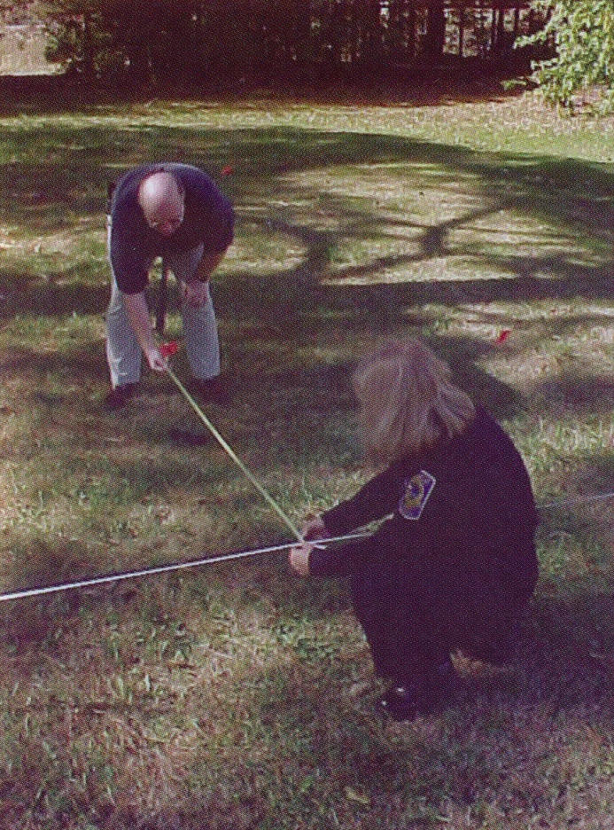
Taking Offset Measurements
Hold the end of the tape directly over the point you want to measure
Read off:
  distance along the base line
  distance along the tape

Slide 10
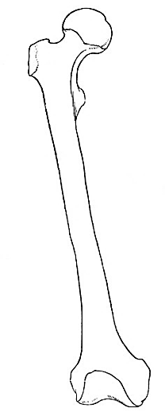
Taking Offset Measurements
How many points do you need to measure per item?
Base line cm | Offset cm | Notes
1.4 | 12.7 | Prox end of femur
3.5 | 14.3 | Midpoint of trochanter
10.2 | 5.5 | Distal end femur
0
12.7cm
5
14.3cm
10
5.5cm
15
cm
Baseline

Slide 11
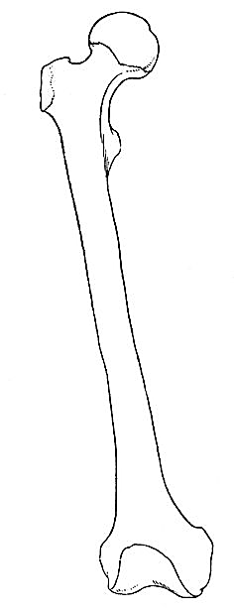
Taking Offset Measurements
A
Base line cm | Offset cm | Notes
1.4 | 12.7 | A
3.5 | 14.3 | B
10.2 | 5.5 | C
B
If you find it easier, use a sketch to show the location of each point you measured
C

Slide 12

Warning!
Make sure the offset crosses the base line at right angles
IMPORTANT
  The zero end of the offset tape should be over the object you are surveying, the spool end over the baseline
X

Slide 13

Taking Offset Measurements
The same person should read off both measurements
One person measures
One holds the tape over object points
One/two people can record measurements
Take turns – everyone should have a go at each role

Slide 14
Shortcuts with Circular Objects
Base line | Offset | Notes
14.9 | 10.2 | Centre of object
 |  | Diameter = 4.8cm
0
5
10
10.2cm
15
cm

Slide 15

Create a scale to fit your graph paper and scatter. Need a smaller scale for larger scenes.
Draw on your baseline and points according to your scale.
Use pictures to help draw in detail (i.e. folds of shirts, labels)
Include a title, date, north arrow, key, use a sharp pencil…
0
100
1:10cm

Slide 16
Sketching your Evidence
Base line cm | Offset cm | Notes
1.4 | 12.7 | Prox end of femur (A)
3.5 | 14.3 | Midpoint of trochanter (B)
10.2 | 5.5 | Distal end femur (C)
5
10
15
cm
0
1.4
3.5
cm
10
10.2
Baseline

Slide 17

Datum Point
Plans should have a fixed point, so that they can be located in space
  A large permanent feature of the landscape
  Edge of building, perimeter of fence, large tree, telegraph pole etc.
Need to describe this and mark this on the plan (use a legend)
Decide on a datum point BEFORE you set up your baseline
  Needs to be in line with your baseline!

Slide 18
Your task…
You have been called by Staffordshire Police to offer forensic assistance at a crime scene.
Bones have been discovered on campus and the police are requesting a full forensic plan of the remains and their associated artefacts for their records.
You need to:
  Locate the remains and associated evidence
  Identify what evidence is present
  Determine a datum point
  Lay an appropriate baseline through the scene
  Take a series of baseline and offset measurements for each piece of evidence
  Create a to-scale crime scene plan back in the lab (with labels)

